Slide 1
Intro to Networking and ARP
CS 161 Fall 2022 - Lecture 16

Slide 2
Last Time: SQL Injection
Web servers interact with databases to store data
Web servers use SQL to interact with databases
SQL injection: Untrusted input is used as parsed SQL
The attacker can construct their own queries to run on the SQL server!
Blind SQL injection: SQLi with little to no feedback from the SQL query
Defense: Input sanitization
Difficult to implement correctly
Defense: Prepared statements
Data only ever treated as data; bulletproof!
Command injection: Untrusted input is used as any parsed language
Defense: Keep it simple and use safe API calls

Slide 3
Last Time: CAPTCHAs
CAPTCHA: A challenge that is easy for a human to solve, but hard for a computer to solve
Examples: Reading distorted text, identifying images
Original purpose: Distinguishing between humans and bots
Modern purpose: Forces the attacker to spend some money to solve the CAPTCHAs
Modern purpose: Providing training data for machine learning algorithms
Issues with CAPTCHAs
As computer algorithms get smarter, CAPTCHAs get harder, and not all humans are able to solve them easily
Ambiguity: CAPTCHAs might be so hard that the validator doesn't know the solution either!
Not all bots are bad

Slide 4
Today: Intro to Networking
Internet: A global network of computers
OSI model: A layered model of protocols

Slide 5
What’s the Internet?

Slide 6
What’s the Internet?
Network: A set of connected machines that can communicate with each other
Machines on the network agree on a protocol, a set of rules for communication
Internet: A global network of computers
The web sends data between browsers and servers using the Internet
The Internet can be used for more than the web (e.g. SSH)

Slide 7
Protocols
A protocol is an agreement on how to communicate that specifies syntax and semantics
Syntax: How a communication is specified and structured (format, order of messages)
Semantics: What a communication means (actions taken when sending/receiving messages)
Example: Protocol for asking a question in lecture?
The student should raise their hand
The student should wait to be called on by the speaker or wait for the speaker to pause
The student should speak the question after being called on or after waiting
If the student has been unrecognized after some time: Vocalize with “Excuse me!”

Slide 8
Layering: The OSI Model

Slide 9

Layering
Internet design is partitioned into various layers. Each layer…
Has a protocol
Relies on services provided by the layer below it
Provides services to the layer above it
Analogous to the structure of an application and the “services” that each layer relies on and provides
Code You Write
Run-Time Library
System Calls
Device Drivers
Fully isolated from user programs
Voltage Levels/Magnetic Domains

Slide 10

Example: Sending Mail
Alice
Bob
I am hungry.

Slide 11

Example: Sending Mail
Alice
Bob
Send to: Bob
I am hungry.

Slide 12

Example: Sending Mail
Alice
Bob
Mail to: 123 Bob St
Send to: Bob
I am hungry.

Slide 13
Example: Sending Mail
Alice
Bob
Mail to: 123 Bob St
Send to: Bob
I am hungry.

Slide 14
Example: Sending Mail
Alice
Bob
Send to: Bob
I am hungry.

Slide 15
Example: Sending Mail
Alice
Bob
I am hungry.

Slide 16
Example: Sending Mail
Each layer communicates with each other, relying on abstractions below them!
Alice
Bob
Relies upon: Sending messages to people
Provides: Sending messages to people
Relies upon: Sending messages to addresses
Provides: Sending messages to addresses

Slide 17
OSI Model
OSI model: Open Systems Interconnection model, a layered model of Internet communication
Originally divided into 7 layers
But layers 5 and 6 aren’t used in the real world, so we ignore them
And we’ll talk about layer 4.5 for encryption later
Same reliance upon abstraction
A layer can be implemented in different ways without affecting other layers
A layer’s protocol can be substituted with another protocol without affecting other layers
7
Application
4
Transport
3
(Inter) Network
2
Link
1
Physical

Slide 18
Layer 1: Physical Layer
Provides: Sending bits from one device to another
Encodes bits to send them over a physical link
Patterns of voltage levels
Photon intensities
RF modulation
Examples
Wi-Fi radios (IEEE 802.11)
Ethernet voltages (IEEE 802.3)
7
Application
4
Transport
3
(Inter) Network
2
Link
1
Physical

Slide 19
Layer 1: Physical Layer
Physical layer: “How do I transmit this sequence of 0’s and 1’s from A to B?”
7
Application
4
Transport
A
01110111…01
B
3
(Inter) Network
2
Link
1
Physical
Next: How do we talk to more than one device?

Slide 20
Layer 2: Link Layer
Provides: Sending frames directly from one device to another
Relies upon: Sending bits from one device to another
Encodes messages into groups of bits called “frames”
Examples
Ethernet frames (IEEE 802.3)
7
Application
4
Transport
3
(Inter) Network
2
Link
1
Physical

Slide 21
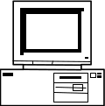
Layer 2: Link Layer
Local area network (LAN): A set of computers on a shared network that can directly address one another
Consists of multiple physical links
Frames must consist of at least 3 things:
Source (“Who is this message coming from?”)
Destination (“Who is this message going to?”)
Data (“What does this message say?”)
Source: A
Destination: C
“Hello, this is A…”
A
B
C
D

Slide 22
Layer 2: Link Layer
In reality, computers aren’t all connected to the same wire
Instead, local networks are a set of point-to-point links
However, Layer 2 still allows direct addressing between any two devices
Enabled by transmitting a frame across multiple physical links until it reaches its destination
Provides an abstraction of a “everything is connected to one wire”
Source: A
Dest: C
“Hello, this is A…”
B
A
E
D
C

Slide 23
Ethernet and MAC Addresses
Source MAC Address (6 bytes)
Destination MAC Address (6 bytes)
VLAN Tag (4 bytes) |  |  |  | Type (2 bytes)
Data (variable-length)
Ethernet header
Notes:
TODO: Nick made this a white slide, but should it be?

Slide 24
Ethernet and MAC Addresses
Ethernet: A common layer 2 protocol that most endpoint devices use
MAC address: A 6-byte address that identifies a piece of network equipment (e.g. your phone’s Wi-Fi controller)
Stands for Media Access Control, not message authentication code
Typically represented as 6 hex bytes: 13:37:ca:fe:f0:0d
The first 3 bytes are assigned to manufacturers (i.e. who made the equipment)
This is useful in identifying a device
The last 3 bytes are device-specific

Slide 25
Layer 2: Link Layer
Link layer: “How do I transmit this frame from A to C, making sure that no one else thinks the message is for them?”
7
Application
Source: A
Dest: C
“Hello, this is A…”
4
Transport
3
(Inter) Network
A
B
C
D
2
Link
1
Physical
Next: How do we address every device in existence?

Slide 26
Layer 3: Network Layer
Provides: Sending packets from any device to any other device
Relies upon: Sending frames directly from one device to another
Encodes messages into groups of bits called “packets”
Bridges multiple LANs to provide global addressing
Examples
Internet Protocol (IP)
7
Application
4
Transport
3
(Inter) Network
2
Link
1
Physical

Slide 27
Layer 3: Network Layer
Recall the ideal layer 2 model: All devices can directly address all other devices
This would not scale to the size of the Internet!
Instead, allow packets to be routed across different devices to reach the destination
Each hop is allowed to use its own physical and link layers!
Basic model:
Is the destination of the packet directly connected to my LAN?
Pass it off to Layer 2
Otherwise, route the packet closer to the destination
A
B
C
D
Router
E
F
G
H

Slide 28
Layer 3: Network Layer
C
Source: A
Destination: D
“Hello, this is A…”
A
D
Router
Router
Router
Router
Router
E
B
Router
Router

Slide 29
Layer 3: Network Layer
This link could be Wi-Fi
C
Source: A
Destination: D
“Hello, this is A…”
And this link could be Ethernet
A
D
Router
Router
Router
But the Internet protocol stays the same, end to end
Router
Router
E
B
Router
Router

Slide 30
Layer 3: Network Layer
Packets must consist of at least 3 things:
Source (“Who is this message coming from?”)
Destination (“Who is this message going to?”)
Data (“What does this message say?”)
Similar to frames (layer 2)
Packets may be fragmented into smaller packets
Different links might support different maximum packet sizes
Up to the recipient to reassemble fragments into the original packet
In IPv4, any node may fragment a packet if it is too large to route
In IPv6, the sender must fragment the packet themselves
Each router forwards a given packet to the next hop
We will cover how a router knows how to forward—and attacks on it—in the future
Packets are not guaranteed to take a given route
Two packets with the same source and destination may take different routes
Notes:
Ask: Why take different routes? What might happen?

Slide 31
Internet Protocol (IP)
Version (4 bits) |  | Header Length (4 bits) |  | Type of Service (6 bits) |  |  | ECN (2 bits) | Total Length (16 bits)
Identification (16 bits) |  |  |  |  |  |  |  | Flags (3 bits) |  | Fragment Offset (13 bits)
Time to Live (8 bits) |  |  |  | Protocol (8 bits) |  |  |  | Header Checksum (16 bits)
Source Address (32 bits)
Destination Address (32 bits)
Options (variable length)
Data (variable length)
IPv4 header
Notes:
Notice: Source address, destination address, header checksum, fragment offset, and data

Slide 32
Internet Protocol (IP)
Internet Protocol (IP): The universal layer-3 protocol that all devices use to transmit data over the Internet
IP address: An address that identifies a device on the Internet
IPv4 is 32 bits, typically written as 4 decimal octets, e.g. 35.163.72.93
IPv6 is 128 bits, typically written as 8 groups of 2 hex bytes: 2607:f140:8801::1:23
If digits or groups are missing, fill with 0’s, so 2607:f140:8801:0000:0000:0000:0001:0023
Globally unique from any single perspective
For now, you can think of them as just being globally unique
IP addresses help nodes make decisions on where to forward the packet

Slide 33
Reliability
Reliability ensures that packets are received correctly or, if random errors occur, not at all
This is implemented with a checksum
However, there is no cryptographic MAC, so there are no guarantees if an attacker modifies packets
IP is unreliable and only provides a best effort delivery service, which means:
Packets may be lost (“dropped”)
Packets may be corrupted
Packets may be delivered out of order
It is up to higher level protocols to ensure that the connection is reliable

Slide 34
Layer 3: Network Layer
Layer 3: “How do I get this packet from A to D?”
C
Source: A
Destination: D
“Hello, this is A…”
Next: How do we reliably send any length of data, not just packets?
A
D
Router
Router
Router
Router
Router
E
B
Router
Router

Slide 35
Layer 4: Transport Layer
Provides: Transportation of variable-length data from any point to any other point
Relies upon: Sending packets from any device to any other device
Builds abstractions that are useful to applications on top of layer 3 packets
Useful abstractions
Reliability: Transmit data reliably, in order
Ports: Provide multiple “addresses” per real IP address
Examples
TCP: Provides reliability and ports
UDP: Provides ports, but no reliability
We’ll talk a lot about these protocols soon!
7
Application
4
Transport
3
(Inter) Network
2
Link
1
Physical

Slide 36
Layer 4: Transport Layer
I am now sending an arbitrary length message that will probably be broken into several packets…
Unreliable Internet
A
D
Layer 4: “How do I transport this arbitrary data over an unreliable medium?”

Slide 37
Layer 7: Application Layer
Provides: Applications and services to users!
Relies upon: Transportation of variable-length data from any point to any other point
Every online application is Layer 7
Web browsing
Online video games
Messaging services
Video calls (Zoom)
7
Application
4
Transport
3
(Inter) Network
2
Link
1
Physical

Slide 38
Layers of Abstraction and Headers
As you move to lower layers, you wrap additional headers around the message
As you move to higher layers, you peel off headers around the message
When sending a message we go from the highest to the lowest layer
When receiving a message we go from the lowest to highest layer

Slide 39
Example: HTTP Request
HTTP
GET / HTTP/1.1
...
HTTP
TCP
TCP
IP
IP
Ethernet
Ethernet
Wires
Wires

Slide 40
Example: HTTP Request
HTTP
HTTP
From: Port 1234
To: Port 80
TCP
GET / HTTP/1.1
...
TCP
IP
IP
Ethernet
Ethernet
Wires
Wires

Slide 41
Example: HTTP Request
HTTP
HTTP
Final destination
From: 1.2.3.4
To: 5.6.7.8
TCP
TCP
From: Port 1234
To: Port 80
IP
GET / HTTP/1.1
...
IP
Ethernet
Ethernet
Wires
Wires

Slide 42
Example: HTTP Request
HTTP
HTTP
Address of next hop
TCP
From: 20:61:84:3a:a9:52
To: 6d:36:ff:4a:32:92
TCP
From: 1.2.3.4
To: 5.6.7.8
IP
IP
From: Port 1234
To: Port 80
Ethernet
GET / HTTP/1.1
...
Ethernet
Wires
Wires

Slide 43
Example: HTTP Request
HTTP
HTTP
TCP
TCP
Converted into bits and transmitted
IP
From: 20:61:84:3a:a9:52
To: 6d:36:ff:4a:32:92
IP
From: 1.2.3.4
To: 5.6.7.8
Ethernet
Ethernet
From: Port 1234
To: Port 80
GET / HTTP/1.1
...
Wires
Wires

Slide 44
Example: HTTP Request
HTTP
HTTP
TCP
TCP
Received over the physical medium
IP
From: 89:8d:33:25:47:24
To: d5:a9:20:68:e0:80
IP
Notice: The MAC addresses changed because the recipient is on a different network
From: 1.2.3.4
To: 5.6.7.8
Ethernet
Ethernet
From: Port 1234
To: Port 80
GET / HTTP/1.1
...
Wires
Wires

Slide 45
Example: HTTP Request
HTTP
HTTP
TCP
TCP
From: 89:8d:33:25:47:24
To: d5:a9:20:68:e0:80
From: 1.2.3.4
To: 5.6.7.8
IP
IP
From: Port 1234
To: Port 80
Ethernet
GET / HTTP/1.1
...
Ethernet
Wires
Wires

Slide 46
Example: HTTP Request
HTTP
HTTP
From: 1.2.3.4
To: 5.6.7.8
TCP
TCP
From: Port 1234
To: Port 80
IP
GET / HTTP/1.1
...
IP
Ethernet
Ethernet
Wires
Wires

Slide 47
Example: HTTP Request
HTTP
HTTP
From: Port 1234
To: Port 80
TCP
GET / HTTP/1.1
...
TCP
IP
IP
Ethernet
Ethernet
Wires
Wires

Slide 48
Example: HTTP Request
HTTP
GET / HTTP/1.1
...
HTTP
TCP
TCP
IP
IP
Ethernet
Ethernet
Wires
Wires

Slide 49
Example: HTTP Request
Relies upon: Transport of data
HTTP
HTTP
Provides: Transport of data
Relies upon: Global packet delivery
TCP
TCP
Provides: Global packet delivery
Relies upon: Local frame delivery
IP
IP
Provides: Local frame delivery
Relies upon: Communication of bits
Ethernet
Ethernet
Provides: Communication of bits
Wires
Wires

Slide 50
Summary: Intro to Networking
Internet: A global network of computers
Protocols: Agreed-upon systems of communication
OSI model: A layered model of protocols
Layer 1: Communication of bits
Layer 2: Local frame delivery
Ethernet: The most common Layer 2 protocol
MAC addresses: 6-byte addressing system used by Ethernet
Layer 3: Global packet delivery
IP: The universal Layer 3 protocol
IP addresses: 4-byte (or 16-byte) addressing system used by IP
Layer 4: Transport of data (more on this next time)
Layer 7: Applications and services (the web)
7
Application
4
Transport
3
(Inter) Network
2
Link
1
Physical

Slide 51
Next: Low-Level Network Attacks
Network Attackers
Man-in-the-middle attacker
On-path attacker
Off-path attacker
ARP: Translate IP addresses to MAC addresses
DHCP: Get configurations when first connecting to a network
WPA: Communicate securely in a wireless local network

Slide 52
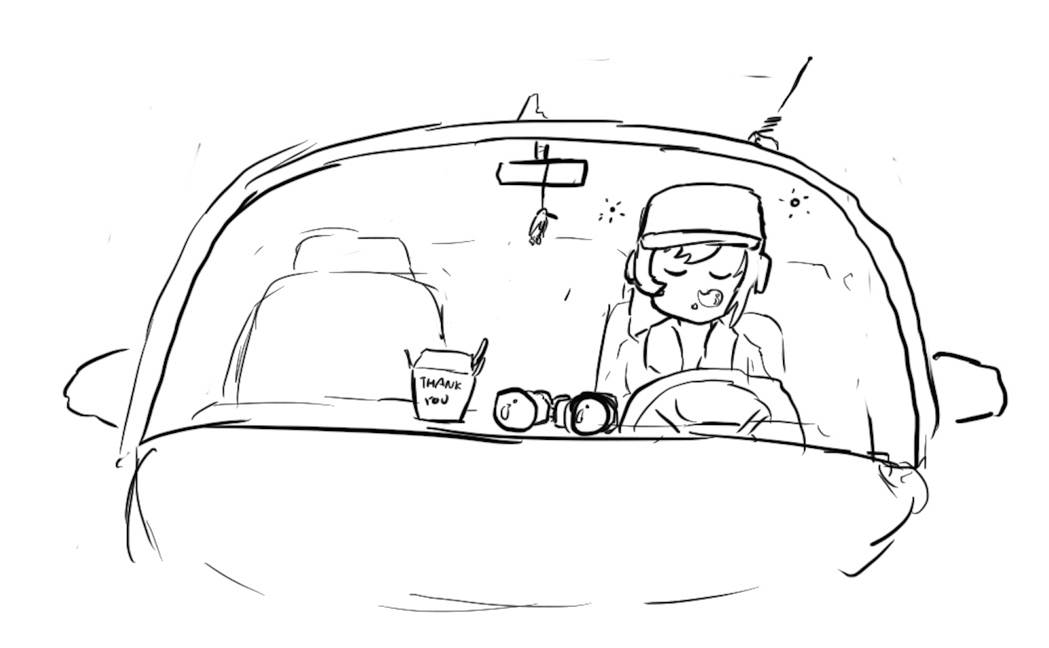
Network Attackers

Slide 53
Types of Network Attackers
Threat model: There are 3 types of attackers we’ll consider
 | Can modify or delete packets | Can read packets
Man-in-the-middle/In-path attacker | ✓ | ✓
Man-on-the-side/On-path attacker |  | ✓
Off-path attacker

Slide 54
Spoofing
Anybody can send their own packets through the network
Spoofing: Lying about the identity of the sender
Example: Mallory sends a message and says the message is from Alice
The attacker can lie about the source address in the packet header
All types of attackers can spoof packets
However, some spoofing attacks may be harder if the attacker can’t read or modify packets

Slide 55
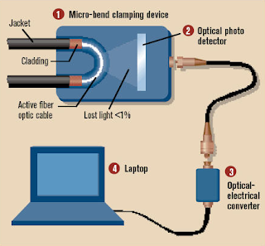
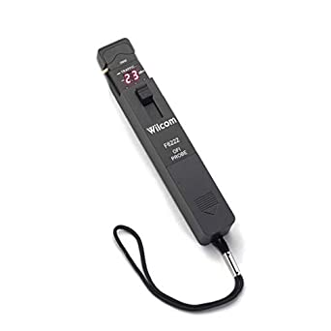
Real-World On-Path Attackers
How might a real-life attacker read packets?
Layer 1 attack: Use a special device to read bits being transmitted across space

Slide 56

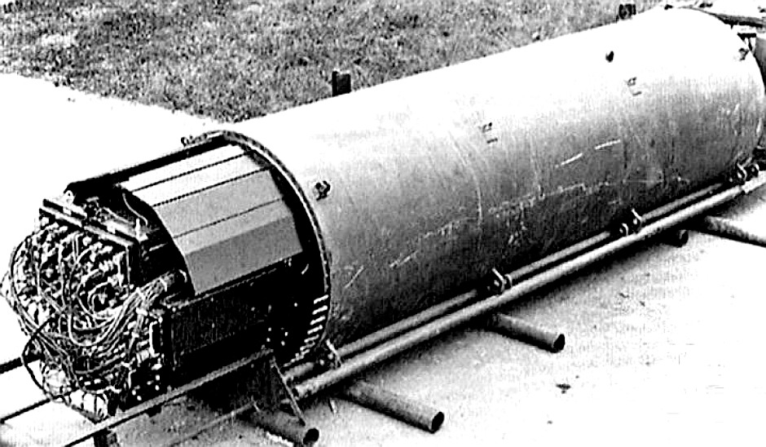
Real-World On-Path Attackers
Operation Ivy Bells
Matthew Carle | February 6, 2017
In an effort to alter the balance of the Cold War, divers from the USS Halibut scoured the ocean floor for a five-inch diameter cable that carried secret Soviet communications between military bases. The divers found the cable and installed a listening device. Upon their return to the United States, the NSA analyzed the recordings and found that a surprising amount of sensitive Soviet information travelled through the lines without encryption. The original tap was later discovered by the Soviets and is now on exhibit at the KGB museum in Moscow.
Notes:
https://www.military.com/history/operation-ivy-bells.html

Slide 57
Real-World On-Path Attackers
Layer 2 attack: Read packets sent across the local area network (LAN)
Recall: A LAN is a network of connected machines
Any machine on the LAN can send packets to any other machine on the LAN
Some LANs use broadcast technologies
Every packet gets sent to every machine on the LAN
Each machine agrees to ignore packets where the destination is a different machine
A machine can break the agreement and read packets meant for other machines
This is called promiscuous mode
May require root access on the machine
A
B
C
D

Slide 58
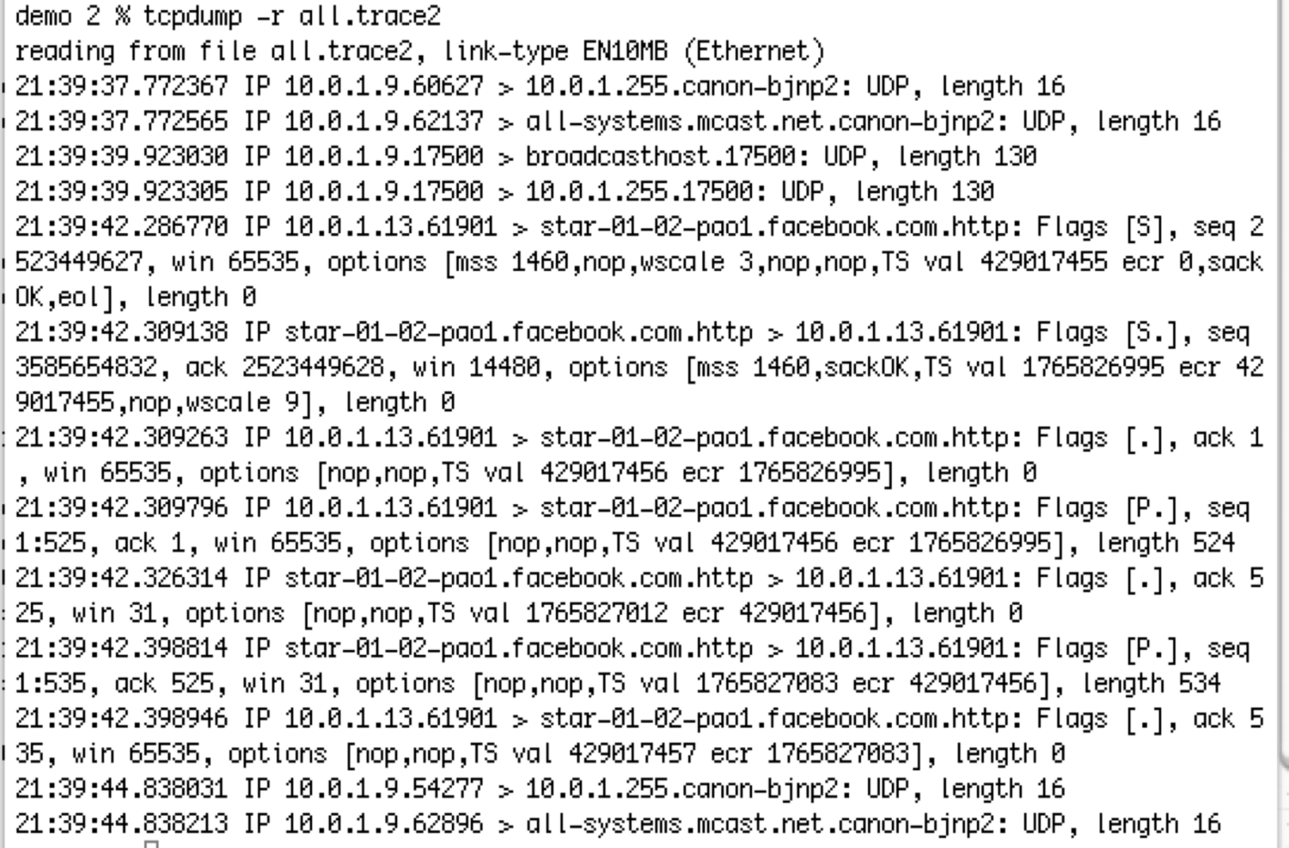
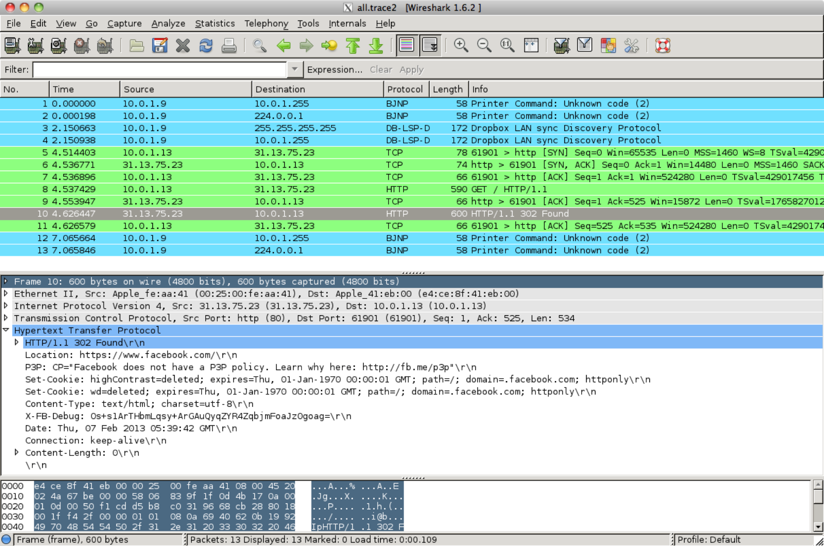
Real-World On-Path Attackers
tcpdump: A program for reading packets on the local network
Uses promiscuous mode to read other machines’ packets in broadcast techonlogies
Wireshark: A graphical user interface (GUI) for analyzing tcpdump packets

Slide 59
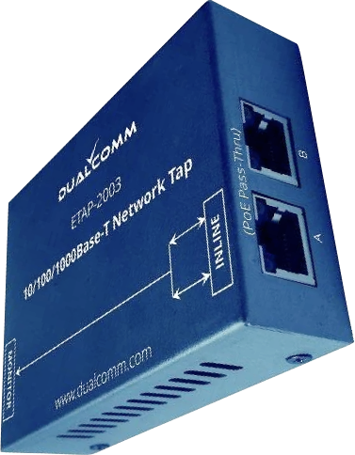
Real-World On-Path Attackers
Some layer 2 (Ethernet) devices can be configured to also send a copy of every packet to the attacker
Many switches support this through “port mirroring”
Or you can use dedicated Ethernet taps
Example: DualComm ETAP-2003
Cost: $200
Powered with USB (no extra power supply needed)
ETAP-2003R extra fun: Attacker can also send packets
Alice
To: Bob
“Hi”
Ethernet Device
To: Bob
“Hi”
To: Bob
“Hi”
Attacker
Bob

Slide 60
The Law and Sniffing Packets
You are allowed to sniff packets on your own network
After all, it is your computers you are using
Network administrators are allowed for network operation
Strongly encourage you to do so at home and see what you see!
It is both grossly immoral and highly illegal to sniff traffic otherwise
It is called “wiretapping”
So do not do this at Starbucks or other networks
Unless you add a filter to only include packets to/from your computer for debugging purposes

Slide 61
Address Resolution Protocol (ARP)

Slide 62
Review: Layer 2 and Layer 3
Local area network (LAN): A set of machines connected in a local network
The MAC identifies devices on layer 2
Internet protocol (IP): Many LANs connected together with routers
The IP identifies devices on layer 3
A
B
C
D
Router
E
F
G
H

Slide 63
Address Resolution Protocol (ARP)
ARP: Translates layer 3 IP addresses to layer 2 MAC addresses
Example: Alice wants to send a message to Bob on the local network, but Alice only knows Bob’s IP address (1.2.3.4). To use layer 2 protocols, she must learn Bob’s MAC address.
Steps of the protocol
Alice checks her cache to see if she already knows Bob’s MAC address.
If Bob’s MAC address is not in the cache, Alice broadcasts to everyone on the LAN: “What is the MAC address of 1.2.3.4?”
Bob responds by sending a message only to Alice: “My IP is 1.2.3.4 and my MAC address is ca:fe:f0:0d:be:ef.” Everyone else does nothing.
Alice caches Bob’s MAC address.

Slide 64
Address Resolution Protocol (ARP)
Alice knows Bob’s IP address (1.2.3.4) but wants to learn Bob’s MAC address.
Bob
Charlie
Alice’s cache
IP | MAC
Alice
Dave
Router
1. Alice checks her cache to see if she already knows the MAC address corresponding to 1.2.3.4.
Since her cache is empty, she must make a request to find out.

Slide 65
Address Resolution Protocol (ARP)
Alice knows Bob’s IP address (1.2.3.4) but wants to learn Bob’s MAC address.
Bob
Charlie
Alice’s cache
IP | MAC
Alice
Dave
Router
2. Alice asks everyone else on the local network: “What is the MAC address of 1.2.3.4?”

Slide 66
Address Resolution Protocol (ARP)
Alice knows Bob’s IP address (1.2.3.4) but wants to learn Bob’s MAC address.
Bob
Charlie
Alice’s cache
IP | MAC
Alice
Dave
Router
3. Bob responds: “My IP is 1.2.3.4 and my MAC address is ca:fe:f0:0d:be:ef.”
Everybody else ignores the request.

Slide 67
Address Resolution Protocol (ARP)
Alice knows Bob’s IP address (1.2.3.4) but wants to learn Bob’s MAC address.
Bob
Charlie
Alice’s cache
IP | MAC
1.2.3.4 | ca:fe:f0:0d:be:ef
Alice
Dave
Router
4. Alice adds Bob’s MAC address to her cache.

Slide 68
Address Resolution Protocol (ARP)
If Bob is outside of the LAN, Alice knows this
Bob’s IP is not on the same “subnet” as Alice
But Alice knows the IP address of the “Gateway router”
Recall: The router’s job is to make sure that the packet will be forwarded towards Bob (Layer 3)
So instead Alice generates an ARP request for the gateway router
Layer 2 MAC address of the frame is set to the router
Layer 3 IP address of the packet remains set as Bob's
The router will forward the packet to some other LAN to get it closer to Bob
Notes:
TODO Nick’s slide from FA21

Slide 69
Attacks on ARP
Alice knows Bob’s IP address (1.2.3.4) but wants to learn Bob’s MAC address.
Bob
Charlie
Alice’s cache
IP | MAC
Alice
Mallory
Router
1. Alice checks her cache to see if she already knows the MAC address corresponding to 1.2.3.4.
Since her cache is empty, she must make a request to find out.

Slide 70
Attacks on ARP
Alice knows Bob’s IP address (1.2.3.4) but wants to learn Bob’s MAC address.
Bob
Charlie
Alice’s cache
IP | MAC
Alice
Mallory
Router
2. Alice asks everyone else on the local network: “What is the MAC address of 1.2.3.4?”

Slide 71
Attacks on ARP
Alice knows Bob’s IP address (1.2.3.4) but wants to learn Bob’s MAC address.
Bob
Charlie
Alice’s cache
IP | MAC
Alice
Mallory
Router
3. Before Bob’s response can arrive, Mallory sends a malicious response: “My IP is 1.2.3.4 and my MAC address is 66:66:66:66:66:66.”

Slide 72
Attacks on ARP
Alice knows Bob’s IP address (1.2.3.4) but wants to learn Bob’s MAC address.
Bob
Charlie
Alice’s cache
IP | MAC
1.2.3.4 | 66:66:66:66:66:66
Alice
Mallory
Router
4. Alice adds Mallory’s malicious address to her cache.

Slide 73
Attack: ARP Spoofing
Alice has no way of verifying the ARP response
Spoofing: Any attacker on the network can claim to have the requested IP address
Alice is only expecting one machine to respond, so she will accept the first response
Race condition: As long as the attacker responds faster, the requester will accept the attacker’s response
ARP spoofing requires Mallory to be in the same LAN as Alice
ARP spoofing lets Mallory become a man-in-the-middle (MITM) attacker
Alice thinks that Bob’s MAC address is 66:66:66:66:66:66 (Mallory’s MAC address)
When Alice sends a message to Bob, she is actually sending the message to Mallory
Mallory can modify the message and then send the modified message to Bob

Slide 74
ARP Spoofing: Defenses
Network switches
When Alice wants to send a message to Bob, she sends the message to a switch on the LAN
The switch maintains a cache of MAC to port (physical connection) mappings
If Bob’s MAC address is in the cache, the switch sends the message directly to Bob
Otherwise, the switch broadcasts the message to all computers
Greatly improves efficiency as now the L1 network is no longer a shared media
Enterprise-class switches have additional optional features
Security: An additional IP/MAC cache that responds first, preventing the attacker from seeing repeated requests
Security: Only authorized MAC addresses can connect to specific ports—access control
Isolation: Virtual local area networks (VLANs), which splits a single LAN into isolated parts
Tools like arpwatch track ARP responses and make sure that there is no suspicious activity
Notes:
TODO Nick slide from FA21

